Slide 1

An Introduction to Kaplan-Meier Curves
Steve Simon for
Notes:
Analyzing Repeated Measures Data Workshop: Module 5 The Linear Mixed Model
Copyright 2011 The Analysis Factor http://TheAnalysisFactor.com
1

Slide 2
An Introduction to Kaplan-Meier Curves
Abstract
Survival data models provide interpretation of data representing the time until an event occurs. In many situations, the event is death, but it can also represent the time to other bad events such as cancer relapse or failure of a medical device. It can also be used to denote time to positive events such as pregnancy. Often patients are lost to follow-up prior to death, but you can still use the information about them while they were in your study to better estimate the survival probability over time.

Slide 3
An Introduction to Kaplan-Meier Curves
Abstract (continued)
This is done using the Kaplan-Meier curve, an approach developed by Edward Kaplan and Paul Meier in 1958. In this talk, you will see a simple example using fruit fly data and learn how to interpret the Kaplan-Meier curve to estimate survival probabilities and survival percentiles.
Most of this talk is based on a web page I wrote in 2008: http://www.pmean.com/08/SimpleKm.html

Slide 4
Fruit fly data (round 1)
Where does this data come from?
The following data represents survival time for a group of fruit flies and is a subset of a larger data set found at the Data and Story Library (DASL). The data set has been slightly modified to simplify some of these explanations.
There are 25 flies in the sample, with the first fly dying on day 37 and the last fly dying on day 96. If you wanted to estimate the survival probability for this data, you would draw a curve that decreases by 4% (1/25) every time a fly dies.
.

Slide 5
Fruit fly data (round 1)
At each date, the survival probability drops by 1/25.
37 96% 40 92% 43 88% 44 84% 45 80% 47 76% 49 72% 54 68% 56 64% 58 60% 59 56% 60 52% 61 48% 62 44% 68 40% 70 36% 71 32% 72 28% 73 24% 75 20% 77 16% 79 12% 89 8% 94 4% 96 0%.
.

Slide 6
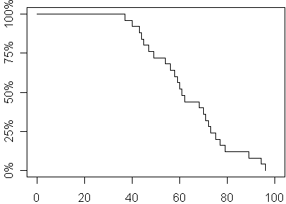
Fruit fly data (round 1)
A graphical depiction of the survival probability

Slide 7
Fruit fly data (round 2)
Let’s alter the experiment
Now let's alter the experiment. Suppose that totally by accident, a technician leaves the screen cover open on day 70 and all the flies escape. You're probably worried that the whole experiment has been ruined. But don't be so pessimistic. You still have complete information on survival of the fruit flies up to their 70th day of life. Here's how you would present the data and estimate the survival probabilities.

Slide 8
Fruit fly data (round 2)
You can still estimate some survival probabilities
37 96% 40 92% 43 88% 44 84% 45 80% 47 76% 49 72% 54 68% 56 64% 58 60% 59 56% 60 52% 61 48% 62 44% 68 40% 70+ ? 70+ ? 70+ ? 70+ ? 70+ ? 70+ ? 70+ ? 70+ ? 70+ ? 70+ ?
.

Slide 9
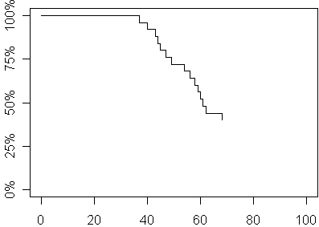
Fruit fly data (round 2)
Here is a graph of the survival probabilities

Slide 10
Fruit fly data (round 2)
What you can still estimate
We clearly have enough data to make several important statements about survival probability. For example, the median survival time is 61 days because roughly half of the flies had died before this day.
By the way, you might be tempted to ignore the ten flies who escaped. But that would seriously bias your results. The median survival time, for example, of the 15 flies who did not escape, for example, is only 54 days which is much smaller than the actual median.

Slide 11
Fruit fly data (round 3)
Another change to the data
Let's look at a third experiment, where the screen cover is left open and all but four of the remaining flies escape. It turns out that those four remaining flies who didn't bug out will allow us to still get reasonable estimates of survival probabilities beyond 70 days. Here is the data and the survival probabilities.

Slide 12
Fruit fly data (round 3)
Here are the estimated survival probabilities
37 96% 40 92% 43 88% 44 84% 45 80% 47 76% 49 72% 54 68% 56 64% 58 60% 59 56% 60 52% 61 48% 62 44% 68 40% 70+ ? 71 30% 70+ ? 70+ ? 75 20% 70+ ? 70+ ? 89 10% 70+ ? 96 0%

Slide 13
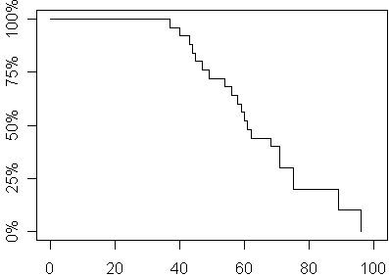
Fruit fly data (round 3)
Here is a graph of the survival probabilities

Slide 14
An Introduction to Kaplan-Meier Curves
Fruit fly data (round 3)
What you do with the six escaped flies is to allocate their survival probabilities equally among the four flies who didn't bug out. This places a great responsibility among each of those four remaining flies since each one is now responsible for 10% of the remaining survival probability, their original 4% plus 6% more which represents a fourth of the 24% survival probability that was lost with the six escaping flies.

Slide 15
Fruit fly data (round 3)
Informative censoring
If the censoring mechanism were somehow related to survival prognosis, then you would have the possibility of serious bias in your estimates. Suppose for example, that only the toughest of flies (those with the most days left in their short lives) would have been able to escape. The flies destined to kick the bucket on days 70, 71, 72, and 73, were already on their deathbeds and unable to fly at all, much less make a difficult escape. Then these censored values would not be randomly interspersed among the remaining survival times, but would constitute some of the larger values. But since these larger values would remain unobserved, you would underestimate survival probabilities beyond the 70th day.

Slide 16
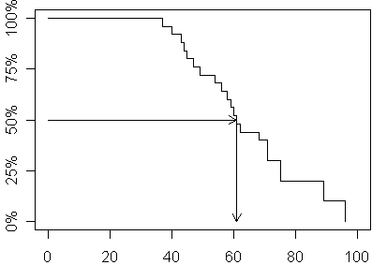
Fruit fly data (round 3)
Interpretation: 50th percentile = 61

Slide 17
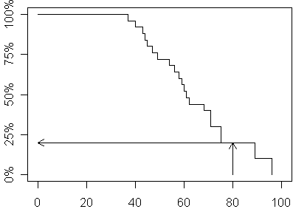
Fruit fly data (round 3)
Interpretation: 80 week survival probability = 20%

Slide 18
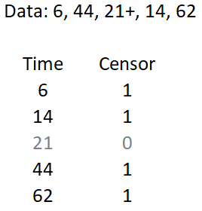
Hand calculation of Kaplan-Meier curve
Table 2.1 of Hosmer, Lemeshow, and May

Slide 19
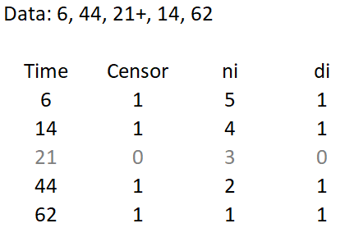
Hand calculation of Kaplan-Meier curve
Calculate number at risk (ni) and deaths (di) at time=i.

Slide 20
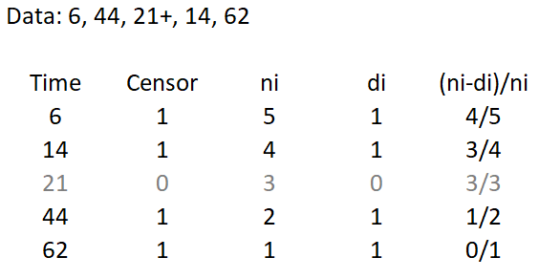
Hand calculation of Kaplan-Meier curve
Calculate the conditional probability of survival.

Slide 21
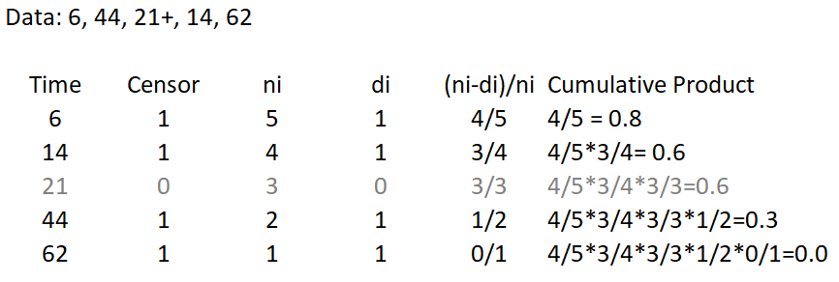
Hand calculation of Kaplan-Meier curve
Compute the cumulative product.

Slide 22
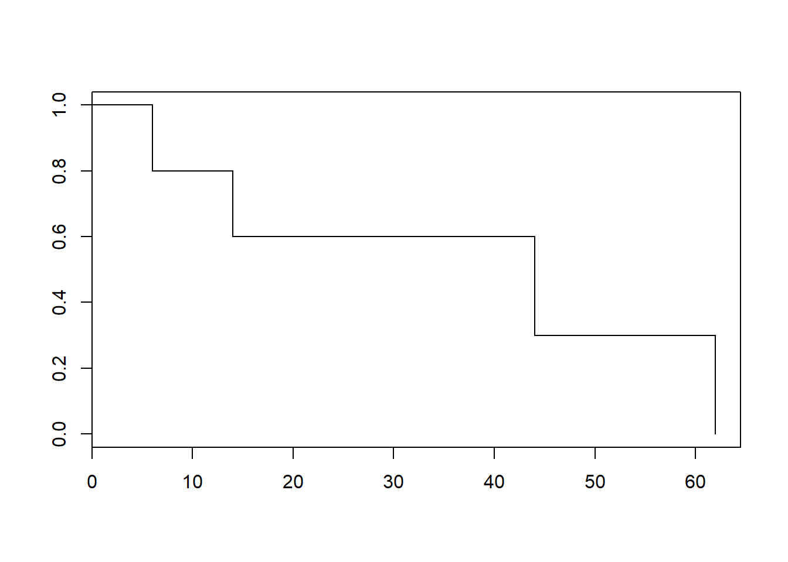
Hand calculation of Kaplan-Meier curve
Here’s a Kaplan-Meier graph, similar to Figure 2.2

Slide 23
Kaplan-Meier curve for a larger data set
WHAS100 data, first six rows
id admitdate foldate los lenfol fstat age gender bmi
1 03/13/1995 03/19/1995 4 6 1 65 0 31.38134
2 01/14/1995 01/23/1996 5 374 1 88 1 22.65790
3 02/17/1995 10/04/2001 5 2421 1 77 0 27.87892
4 04/07/1995 07/14/1995 9 98 1 81 1 21.47878
5 02/09/1995 05/29/1998 4 1205 1 78 0 30.70601
6 01/16/1995 09/11/2000 7 2065 1 82 1 26.45294

Slide 24
Kaplan-Meier curve for a larger data set
Data dictionary for WHAS100
This is a tab delimited file with 100 rows and 9 columns of data.
id, a sequential code from 1 to 100
admitdate, Admission Date, formatted as mm/dd/yyyy
foldate, Follow Up Date, formatted as mm/dd/yyyy
los, Length of Hospital Stay in Days
lenfol, Follow Up Time in Days
fstat, Vital Satus, 1 = Dead, 0 = Alive
age, Age at Admission in years
gender, 0 = Male, 1 = Female
bmi, Body Mass Index, kg/m^2

Slide 25
Kaplan-Meier curve for a larger data set
SAS code
proc lifetest
plots=survival
data=survival.fly1;
time time*censor(0);
run;

Slide 26
Kaplan-Meier curve for a larger data set
R code
fly1_surv <- Surv(fly1$time, fly1$censor)
fly1_km <- survfit(fly1_surv~1)
plot(fly1_km, conf.int=FALSE)

Slide 27
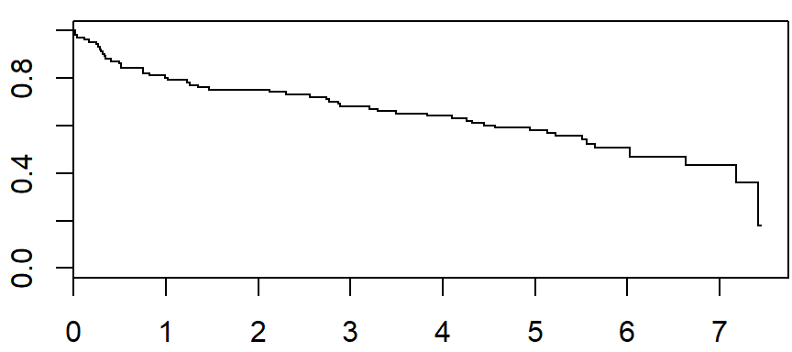
Kaplan-Meier curve for a larger data set
The overall Kaplan-Meier curve (R)

Slide 28
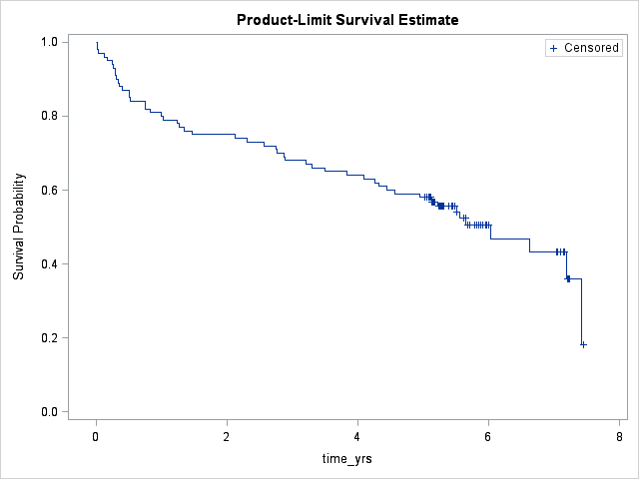
Kaplan-Meier curve for a larger data set
The overall Kaplan-Meier curve (SAS)

Slide 29

Kaplan-Meier curve for a larger data set
Formula for confidence limits
Since the Kaplan-Meier curve is a product of conditional probabilities, you can, with relative ease, compute the variance on a log scale and then transform back to the original scale.
The full derivation requires knowledge of change of variable methods that you might have learned in your mathematical statistics class. Details are on pages 28-29 of Hosmer, Lemeshow, and May. There are other formulas for calculating confidence limits, but the limits based on the variance shown above works well in practice.

Slide 30
Kaplan-Meier curve for a larger data set
Code in SAS/R for confidence limits
R
plot(fly1_km, conf.int=TRUE)
SAS
plots=survival(cl)

Slide 31
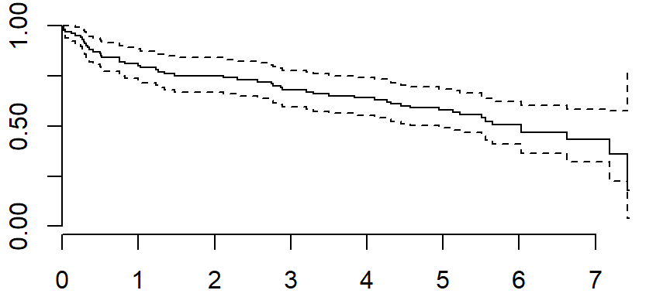
Kaplan-Meier curve for a larger data set
Confidence limits (R)

Slide 32
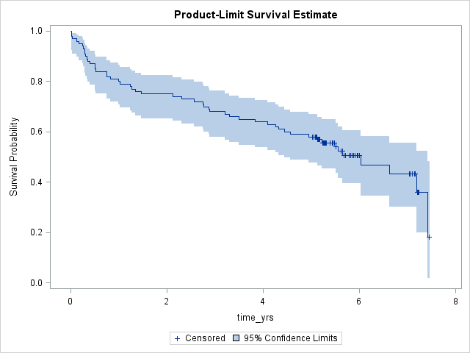
Kaplan-Meier curve for a larger data set
Confidence limits (SAS)

Slide 33
Kaplan-Meier curve for a larger data set
Quartile confidence limits
You can get confidence limits for the median survival time, the quartiles or any other survival percentile by extrapolating horizontally along the confidence limits of the Kaplan-Meier curve.
For some percentiles, the horizontal line may not ever cross the upper confidence limit. In that case, you can set the upper confidence limit to plus infinity.

Slide 34
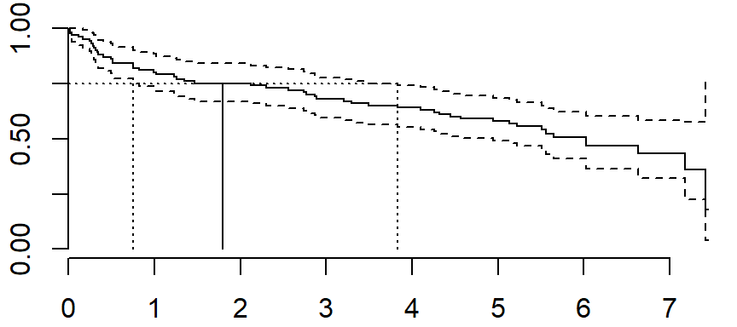
Kaplan-Meier curve for a larger data set
How you can visualize quartile confidence limits.

Slide 35
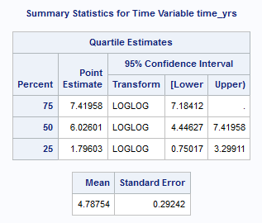
Kaplan-Meier curve for a larger data set
Quartile confidence limits (SAS)
SAS produces quartile confidence limits and estimated mean by default. The mean estimate is biased if the last observation is censored.

Slide 36
Kaplan-Meier curve for a larger data set
Quartile confidence limits (R)
> quantile(whas100_km)
$quantile
25 50 75
1.796030 6.026010 7.419576
$lower
25 50 75
0.7501711 4.9445585 7.1841205
$upper
25 50 75
3.835729 NA NA

Slide 37
Kaplan-Meier curve for a larger data set
Comparing two or more Kaplan-Meier curves
If you want to compare the survival curves for two subgroups, you should first draw the two subgroup Kaplan-Meier curves on the same graph.

Slide 38
Kaplan-Meier curve for a larger data set
Comparing two or more Kaplan-Meier curves (SAS)
proc lifetest
notable
plots=survival
data=survival.whas100;
time time_yrs*fstat(0);
strata gender;
title "Comparison of survival for gender for WHAS100 data";
run;

Slide 39
Kaplan-Meier curve for a larger data set
Comparing two or more Kaplan-Meier curves (R)
whas100_km_by_gender <-
survfit(whas100_surv~whas100$gender)
plot(whas100_km_by_gender, conf.int=FALSE)
survdiff(whas100_surv~whas100$gender)

Slide 40
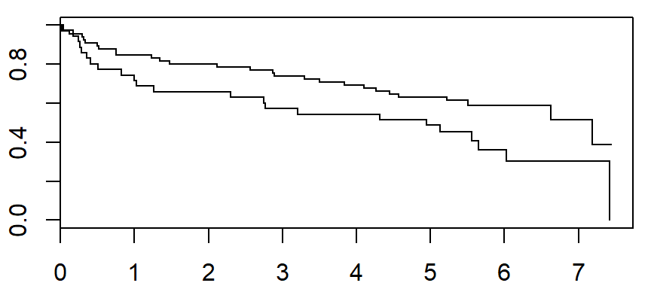
Kaplan-Meier curve for a larger data set
Comparing two or more Kaplan-Meier curves

Slide 41
Kaplan-Meier curve for a larger data set
Adding labels (R)
whas100_km_by_gender %>%
tidy %>%
group_by(strata) %>%
slice(n()) -> km_labels
plot(whas100_km_by_gender, conf.int=FALSE, xlim=c(0,12))
text(km_labels$time, km_labels$estimate,
km_labels$strata, adj=0)

Slide 42
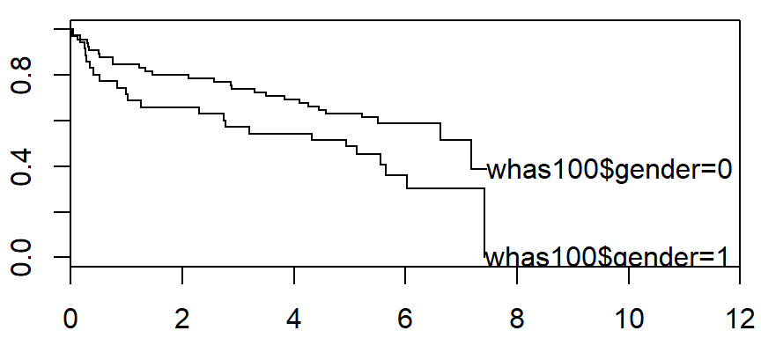
Kaplan-Meier curve for a larger data set
Comparing two or more Kaplan-Meier curves

Slide 43
Kaplan-Meier curve for a larger data set
Adding a legend (R)
whas100_km_by_gender %>%
tidy %>%
ggplot(aes(time, estimate, color=strata)) +
geom_step()

Slide 44
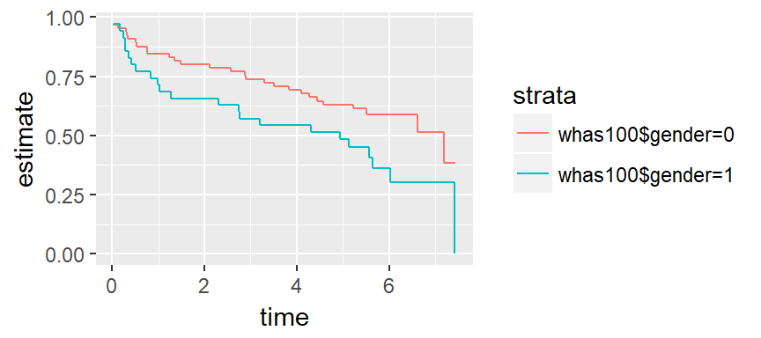
Kaplan-Meier curve for a larger data set
Comparing two or more Kaplan-Meier curves

Slide 45
The log-rank test
Formulation
The formulation of the log-rank test, as described in Hosmer, Lemeshow, and May is a bit opaque.
d_{ij} is the number of events in the i^{th} group at time t_{j} (i=1,2)
n_{ij} is the number of patients at risk in the i^{th} group at time t_{j}
d_{j} = d_{1j} + d_{2j}; n_{j} = n_{1j} + n_{2j}

Slide 46
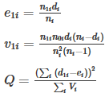
The log-rank test
Formulation found in Hosmer, Lemeshow, and May

Slide 47



The log-rank test
A simpler formulation
This looks a bit mystifying, but if you define
then e_{1i} and v_{1i}
are just the mean of a binomial distribution and the variance of a binomial distribution with a finite population correction factor. Equivalently, the latter is the variance of a hypergeometric distribution.

Slide 48
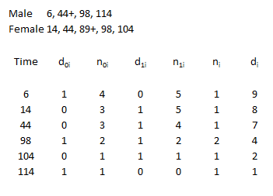
The log rank test
Hand calculation on a small data set
Calculate the number of deaths and the number at risk at each time point.

Slide 49
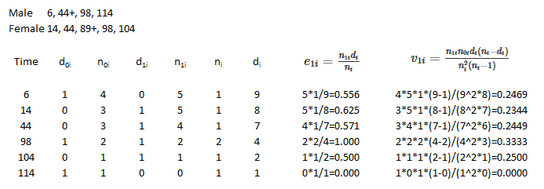
The log rank test
Hand calculation on a small data set
Compute the expected value and variance at each time point.

Slide 50
The log rank test
Log rank test (R)
N Observed Expected (O-E)^2/E (O-E)^2/V
whas100$gender=0 65 28 34.6 1.27 3.97
whas100$gender=1 35 23 16.4 2.68 3.97
Chisq= 4 on 1 degrees of freedom, p= 0.0463

Slide 51
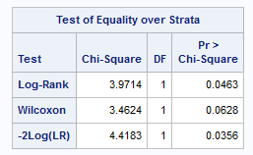
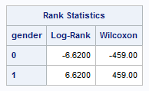
The log rank test
Log rank test (SAS)
Ignore the covariance statistics that SAS produces. They are of limited relevance for more complex settings, but are totally useless for a two group test.

Slide 52
The log rank test
How to handle continuous outcomes
The log rank test cannot easily handle continuous predictor variables. For these variables, you should really consider a more sophisticated model like a Cox proportional hazards model (coming up in the next lecture). But you can get a rough preliminary idea of what is going on with a continuous predictor by categorizing it using one or more cut-points. Here’s an example using age.

Slide 53
The log rank test
How to handle continuous outcomes (R)
age_breaks <- c(0, 59, 69, 79, 99)
age_labels <- c("<60", "60-69", "70-79", ">=80")
whas100$age_group <-
cut(whas100$age, age_breaks, age_labels)
table(whas100$age_group, whas100$fstat)

Slide 54
The log rank test
How to handle continuous outcomes (R)
Make sure that you have enough events in each age group.
0 1
<60 17 8
60-69 16 7
70-79 8 14
>=80 8 22

Slide 55
The log rank test
How to handle continuous outcomes (R)
whas100_km_by_age <-
survfit(whas100_surv~whas100$age_group)
whas100_km_by_age %>%
tidy %>%
ggplot(aes(time, estimate, color=strata)) +
geom_step()
survdiff(whas100_surv~whas100$age_group)

Slide 56
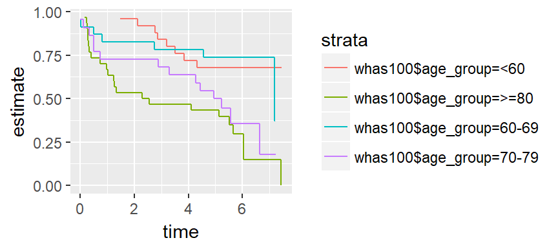
The log rank test
How to handle continuous outcomes (R)

Slide 57
The log rank test
How to handle continuous outcomes (R)
N Observed Expected (O-E)^2/E (O-E)^2/V
whas100$age_group=<60 25 8 15.5 3.64 5.29
whas100$age_group=60-69 23 7 12.9 2.71 3.68
whas100$age_group=70-79 22 14 10.2 1.39 1.76
whas100$age_group=>=80 30 22 12.3 7.57 10.18
Chisq= 15.6 on 3 degrees of freedom, p= 0.00139

Slide 58
The log rank test
How to handle continuous outcomes (SAS)
proc lifetest
notable plots=survival
data=survival.whas100;
time time_yrs*fstat(0);
strata age(60, 70, 80);
title "Comparison of survival for age groups";
run;

Slide 59
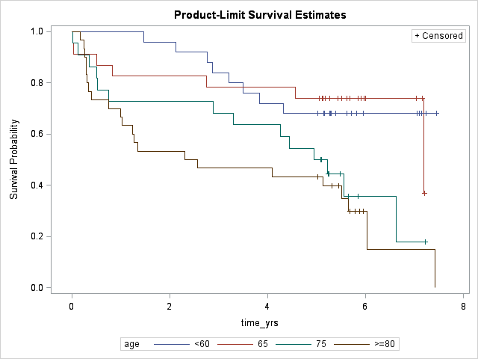
The log rank test
How to handle continuous outcomes (SAS)

Slide 60
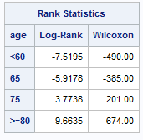
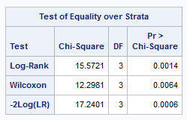
The log rank test
How to handle continuous outcomes (SAS)

Slide 61
The log rank test
Test for trend
The log rank test for more than two groups treats the groups in a nominal fashion—order is not important. For this particular data set, and many others, you might prefer a test for trend. This is available in most statistical packages, but we will not show the details here.

Slide 62
The log rank test
Limitations
The log rank test
works well when you’re comparing a treatment group to a control group
you can also use it when you have three or more groups.
But the log rank test does not extend beyond this:
you cannot include a continuous predictor,
you cannot analyze data with multiple predictors, and
you cannot do risk adjustment.

